Slide 1

Spring MVC

Slide 2
Spring mvc
MVC is one of the most important modules of the Spring Framework. It builds on the powerful Spring IoCcontainer and makes extensive use of the container features to simplify its configuration.
Model-View-Controller (MVC) is a common design pattern in UI design. It decouples business logic from UIs by separating the roles of model, view, and controller in an application. Models are responsible for encapsulating application data for views to present. Views should only present this data, without including any business logic. Controllers are responsible for receiving requests from users and invoking back-end services for business processing. After processing, back-end services may return some data for views to present. Controllers collect this data and prepare models for views to present. The core idea of the MVC pattern is to separate business logic from UIs to allow them to change independently without affecting each other.

Slide 3
Spring mvc
In a Spring MVC application, models usually consist of domain objects that are processed by the service layer and persisted by the persistence layer. Views are usually JSP templates written with the Java Standard Tag Library (JSTL). However, it’s also possible to define views as PDF files, Excel files etc.
The central component of Spring MVC is a front controller. In the simplest Spring MVC application, this controller is the only servlet you need to configure in a Java web deployment descriptor (i.e., the web.xml file or a ServletContainerInitializer). A Spring MVC controller—often referred to as a dispatcher servlet—implements one of Sun’s core Java EE design patterns called Front Controller. It acts as the front controller of the Spring MVC framework, and every web request must go through it so that it can manage the entire request-handling process.

Slide 4
Spring mvc
When a web request is sent to a Spring MVC application, a controller first receives the request. Then it organizes the different components configured in Spring’s web application context or annotations present in the controller itself, all needed to handle the request.

Slide 5
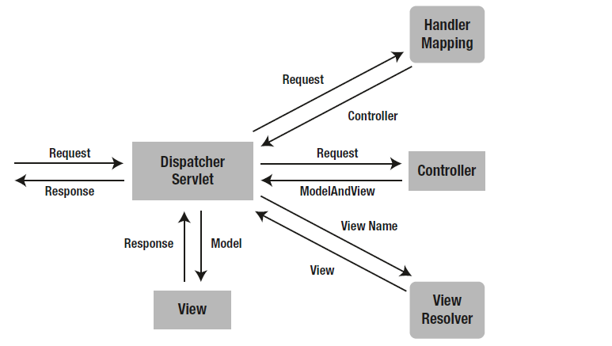
Spring mvc

Slide 6
Spring mvc
Setting up Spring MVC
ServletContainerInitializer
SpringServletContainerInitializer

Slide 7
Spring mvc
Map Exceptions to Views
When an unknown exception occurs, your application server usually displays the evil exception stack trace to the user. Your users have nothing to do with this stack trace and complain that your application is not user friendly. Moreover, it’s also a potential security risk, as you may expose the internal method call hierarchy to users.
1) In a Spring MVC application, you can register one or more exception resolver beans in the web application context to resolve uncaught exceptions. These beans have to implement the HandlerExceptionResolver interface for DispatcherServlet to autodetect them.

Slide 8
Spring mvc
Map Exceptions to Views
To resolve uncaught exceptions, you can write your custom exception resolver by implementing the HandlerExceptionResolver interface. Usually, you’ll want to map different categories of exceptions into different error pages. Spring MVC comes with the exception resolver SimpleMappingExceptionResolver for you to configure the exception mappings in the web application context.
2) Map Exceptions Using @ExceptionHandler
Instead of configuring a HandlerExceptionResolver, you can annotate a method with @ExceptionHandler.It works in a similar way as the @RequestMapping annotation.

Slide 9
Spring mvc
Map Exceptions to Views
3) Generic exception handling with @ControllerAdvice
Although using @ExceptionHandler annotated methods is very powerful and flexible, there
is a drawback when you put them in controllers. Those methods will work only for the controller
they are defined in, so if you have an exception occurring in another controller, these methods won’t be called. Generic exception-handling methods have to be moved to a separate class, and that class has to be annotated with @ControllerAdvice.

